Slide 1
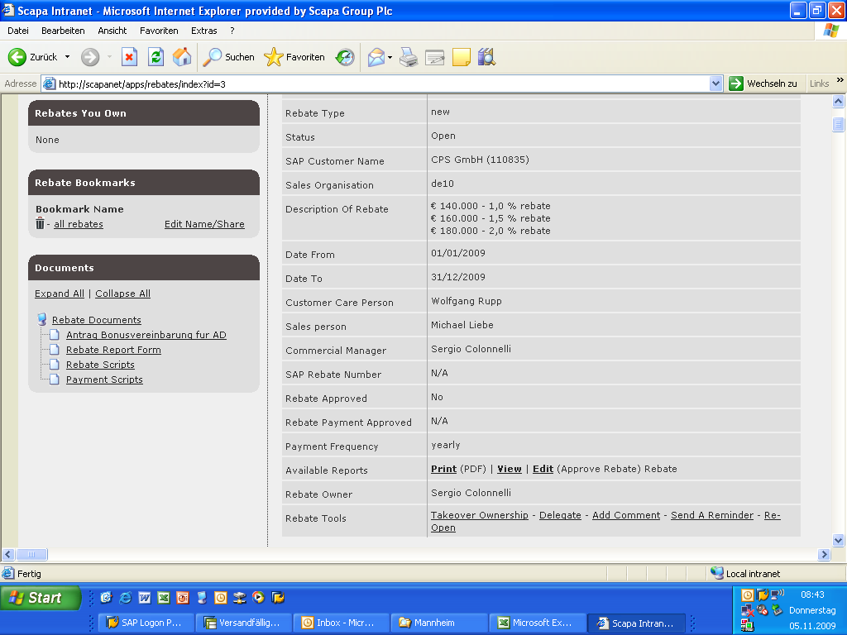
1.) click here

Slide 2
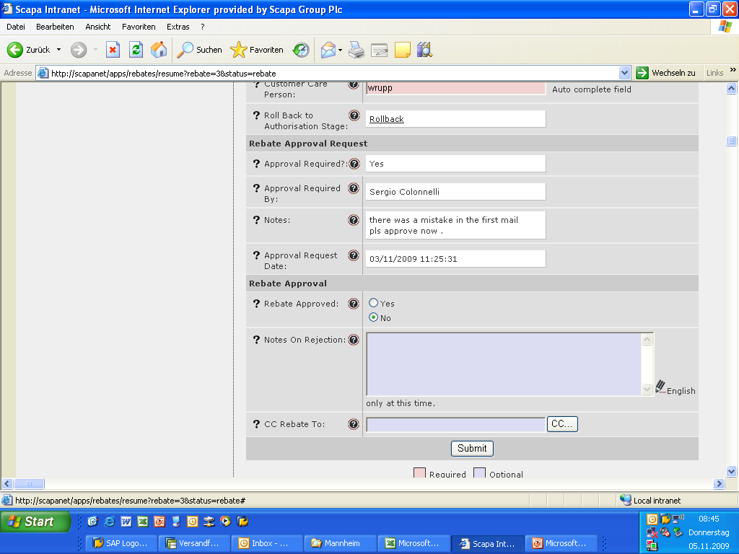
2.) click on approved yes and then submit. it will automatically go back to the right customer care person

